Slide 1
Preliminary Concepts
January 24, 2024

Slide 2
Meeting Agenda
Purpose of the Master Plan for Career Education
Master plan development process and ways to be involved
Preliminary concepts for the master plan
Question and answer period (use the Q&A feature)

Slide 3
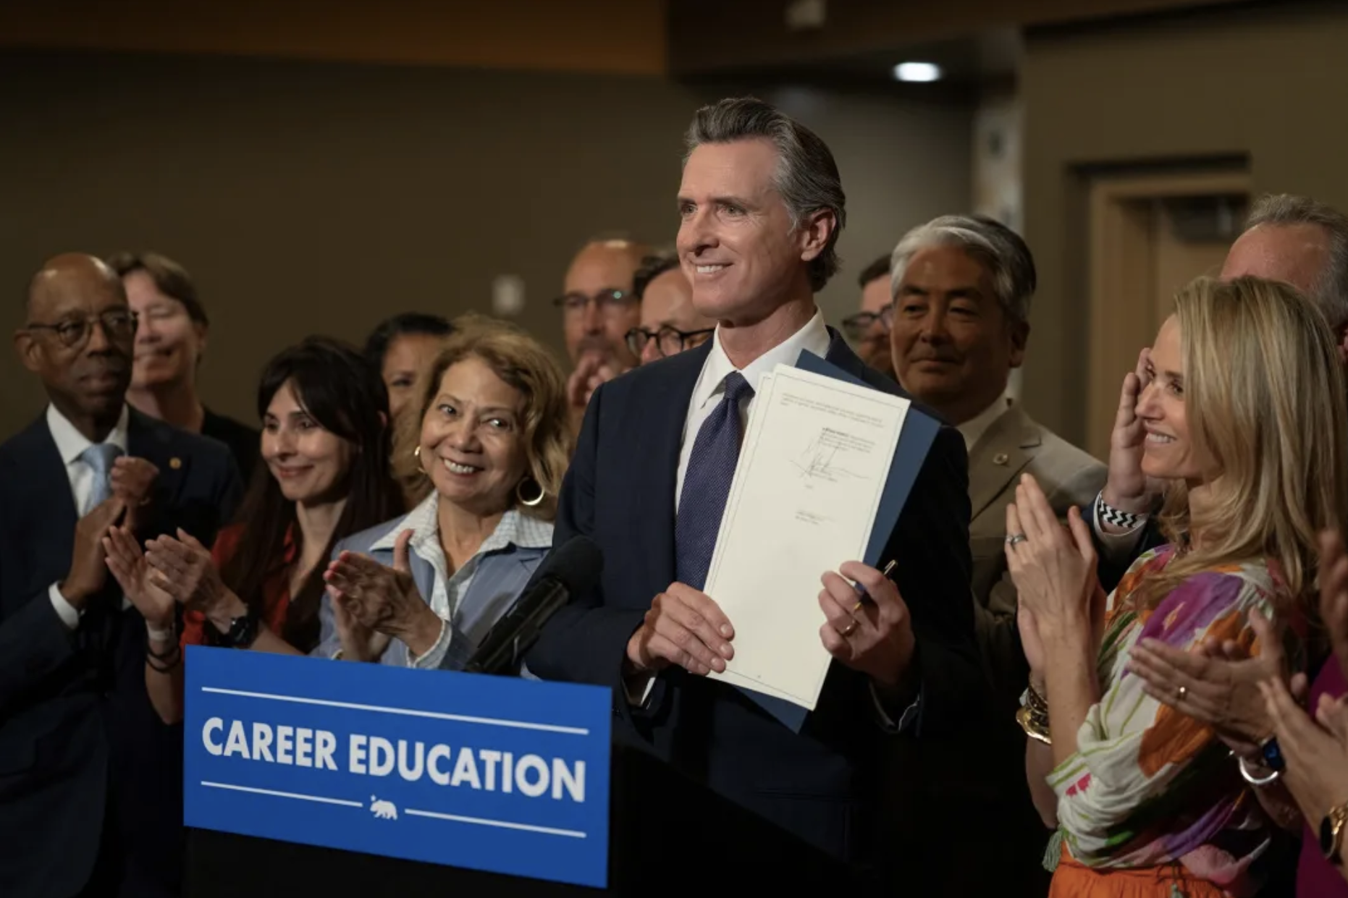
Why We Need a Master Plan for Career Education
We need to prepare California's students and workers—including those currently disconnected from school and jobs—for living wage, fulfilling careers.
This means creating connections between the systems that teach critical skills and that provide needed supports, so people can continue to pursue their goals throughout their lives.
By addressing the structural issues that create unequal opportunities to learn and get credit for knowledge, this approach provides all Californians with the freedom to succeed.
The Master Plan for Career Education helps to actualize the Governor’s commitment to equity, as outlined in Executive Order N-16-22.

Slide 4
Developing the Preliminary Concepts
These ideas are based on:
Written recommendations from the agencies named in Executive Order N-11-23
Written public input
Recommendations on similar topics such as the California State Plan for Career Education and the Student Transfer Achievement Reform Act
More than 30 interviews with interest holders
The preliminary ideas are available in a document on the Career Education website: https://careereducation.gov.ca.gov/

Slide 5
January-June
Developing Big Ideas
Read a summary of the preliminary ideas
Share a recording of this webinar
Attend the eTranscript California Task Force Meetings
Attend a regional meeting
Submit written comments
Invite Governor’s Office representatives to meet with your community or organization
July-September
Refining Recommendations
Join an advisory group (Students & Families, Educators, Workforce Development Entities, Labor & Industry, and Policymakers & Advocates)
Attend advisory group meetings
Submit written comments
Invite Governor’s office representatives to meet with your community or organization
October-November
Taking Action on the Plan
Disseminate the Master Plan on Career Education
Review resources intended to support implementation

Slide 6
Upcoming Regional Meetings
Southern Border: March 1, El Centro
Los Angeles & Orange County: Week of 3/4
Inland Empire: Week of 3/11
Kern County, Central San Joaquin & Central Coast: Week of 3/18
North San Joaquin Valley & Eastern Sierra: Week of 4/8
Far North and Redwood Coast: Week of 4/15
San Francisco Bay Area & Capitol Region: Week of 4/22
Virtual design session: Week of 4/29
Specific dates and registration links will be posted to https://careereducation.gov.ca.gov/ shortly, as they are finalized.

Slide 7
eTranscript California Task Force
Identifying ways to scale existing transcript services for academic purposes and identifying key characteristics for a tool that could be used for skills based hiring
Meetings held monthly on Zoom
Find out more at: https://c2c.ca.gov/meetings/
Note: The first meeting was last week. A recording and a short background paper are posted on the website.

Slide 8
Master Plan for Career Education Concepts

Slide 9
Create state and regional coordinating bodies
that are informed by
statewide data systems and
supported through technical assistance networks

Slide 10
Issues
Education and training programs with similar goals are funded through numerous agencies, base funding, and specialized grant programs.
Short-term, topical funding streams incentivize pilot programs rather than structural change.
Information is not readily available on the outcomes of many education and training programs, or how those outcomes vary for different populations.
Education and training offerings may be misaligned with the changing labor market.

Slide 11
Solutions
Establish a state career coordination body made up of workforce, education, and employer representatives that establishes joint plans and allocates state and federal funding related to educational attainment and career education
Distribute funds through regional career councils that include workforce, education, and employer representatives, which also coordinates regional employer engagement while protecting local employer partnerships

Slide 12
Solutions
Provide information on regional labor markets through a statewide entity that helps to pinpoint education and training needs that would allow specific populations to progress in specific sectors
Implement incentive funding based on a set of common measures that are developed by the state career coordinating body and calculated based on data maintained in the Cradle-to-Career Data System
Coordinate technical assistance at the regional level across service delivery systems to support regional plans while providing appropriate expertise for specific populations and education/training providers

Slide 13
Align regional and state
K-12, postsecondary, and workforce pathways
using a skills framework

Slide 14
Issues
Students and workers don’t know which career opportunities support economic mobility and how to train for those positions.
There are artificial distinctions between college and career, which reinforce stereotypes about who belongs in specific education and career pathways.
Adults have few options for documenting skills built in non-academic contexts.
Rural Californians have limited opportunities to earn degrees in high demand fields without having to move.
Lack of trained educators in high demand occupations make it difficult to teach critical skills.

Slide 15
Solutions
Establish skills-based model pathways in priority sectors, co-developed with K12 educators, postsecondary institutions, workforce training providers, and employers, that include both technical and 21st Century skills
Implement a universal K12 curriculum that supports exploration and provides opportunities for work-based learning starting in middle school
Provide adults with expanded opportunities to explore career options
Establish a statewide strategy to strengthen teacher preparation and credentialing pipelines

Slide 16
Solutions
Coordinate enrollment management across K-12, postsecondary, and workforce entities at the regional level, including stronger integration of adult education and the employer-driven training into community college service delivery systems and expanded online opportunities
Create a shared mechanism for evaluating equivalencies between learning systems, so that community college and dual enrollment courses are universally counted toward specific degrees offered at CSU and UC and adults receive academic credit for learning in noncredit, workforce training, and job settings
Rebuild eTranscript California to provide a mechanism for documenting community college coursework and learning that has been determined to be equivalent to community college courses, supported by universal transcript standards
Work with employers to design a tool that allows learners to curate their academic and work experience to apply for jobs with employers that use skills based hiring

Slide 17
Create incentives and improve coordination to provide
work-based learning opportunities
for K12 students
and adult learners

Slide 18
Issues
Work-based learning opportunities are generally brokered by individual institutions, with varying degrees of connection and quality.
Liability and coordination concerns impede employers from engaging in work-based learning.
Work-based learning is often a volunteer opportunity, above and beyond coursework, and thus not a option for those who must work while in school.
There are fewer work-based learning opportunities in non-technical pathways.

Slide 19
Solutions
Create universal definitions and standards for work-based learning
Create strong incentives for employer participation, including addressing liability and coordination challenges
Ensure that high school students can participate in work-based learning without compromising their ability to qualify for attending a four-year college, such as by offering academic credit for this experience

Slide 20
Solutions
Establish incentives for work-based learning and redesign existing funding streams to support paid opportunities
Align service learning, research, and fellowship programs with specific career pathways
Leverage the regional career councils to coordinate with employers to provide work-based learning

Slide 21
Accelerate the use of
public benefit programs to make education and training affordable and
improve universal access

Slide 22
Issues
The high cost of living means many people must juggle education and training with jobs and family responsibilities and take on debt to cover the full cost of attendance.
Adults and undocumented people have fewer financial aid options and face complex systems to secure eligibility for public benefits.
Existing systems impose considerable barriers for people with disabilities to participate in training and employment.

Slide 23
Solutions
Strengthen mechanisms that encourage families to access benefits that support college savings
Increase access to financial supports so that underserved populations can participate in both short and longer-term training
Create stronger systems for referring learners to social benefit programs
Improve universal access to career pathways

Slide 24
Questions and Answers

Slide 25
Stay Involved!
Visit https://careereducation.gov.ca.gov
Attend a regional meeting
Join a meeting of the eTranscript California task force
Share this presentation and the summary of preliminary concepts
Reach out to our team

